Slide 1
Poetry Final Practice:
Images and Lyrics

Slide 2
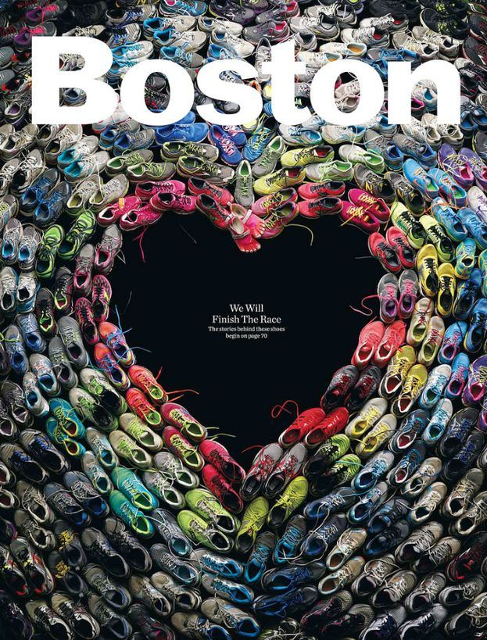
1.
Recently, this image, containing sneakers from actual Boston Marathon runners, appeared online with the message, “We will finish the race.” What literary device is at work?
Hyperbole
Personification
Symbol
onomatopoeia

Slide 3
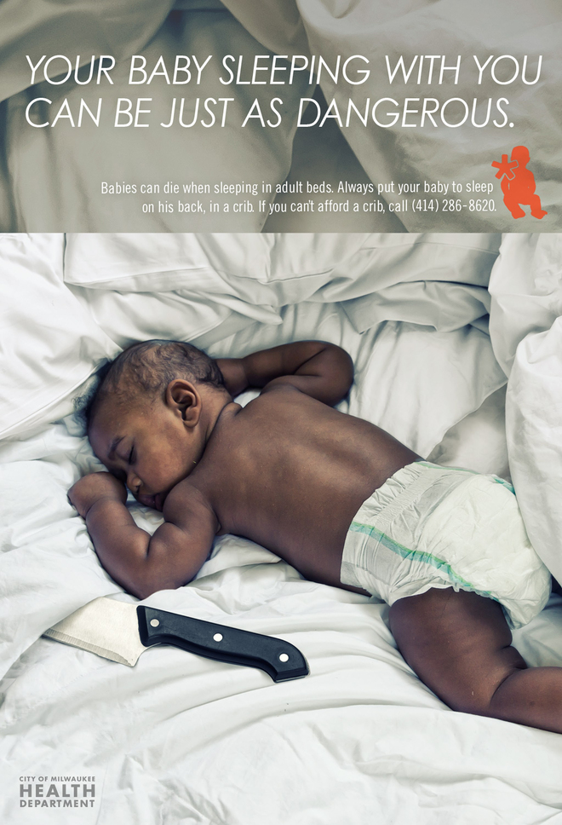
2.
What device is most at work in this ad, run to inform parents of the dangers of letting babies sleep in the bed with them?
Hyperbole
Irony
symbol
flashback

Slide 4
3.
Note the placement of the Burger King sign with the Miami Heart Institute sign. What device is at work?
Onomatopoeia B. Symbol
Simile D. Irony

Slide 5
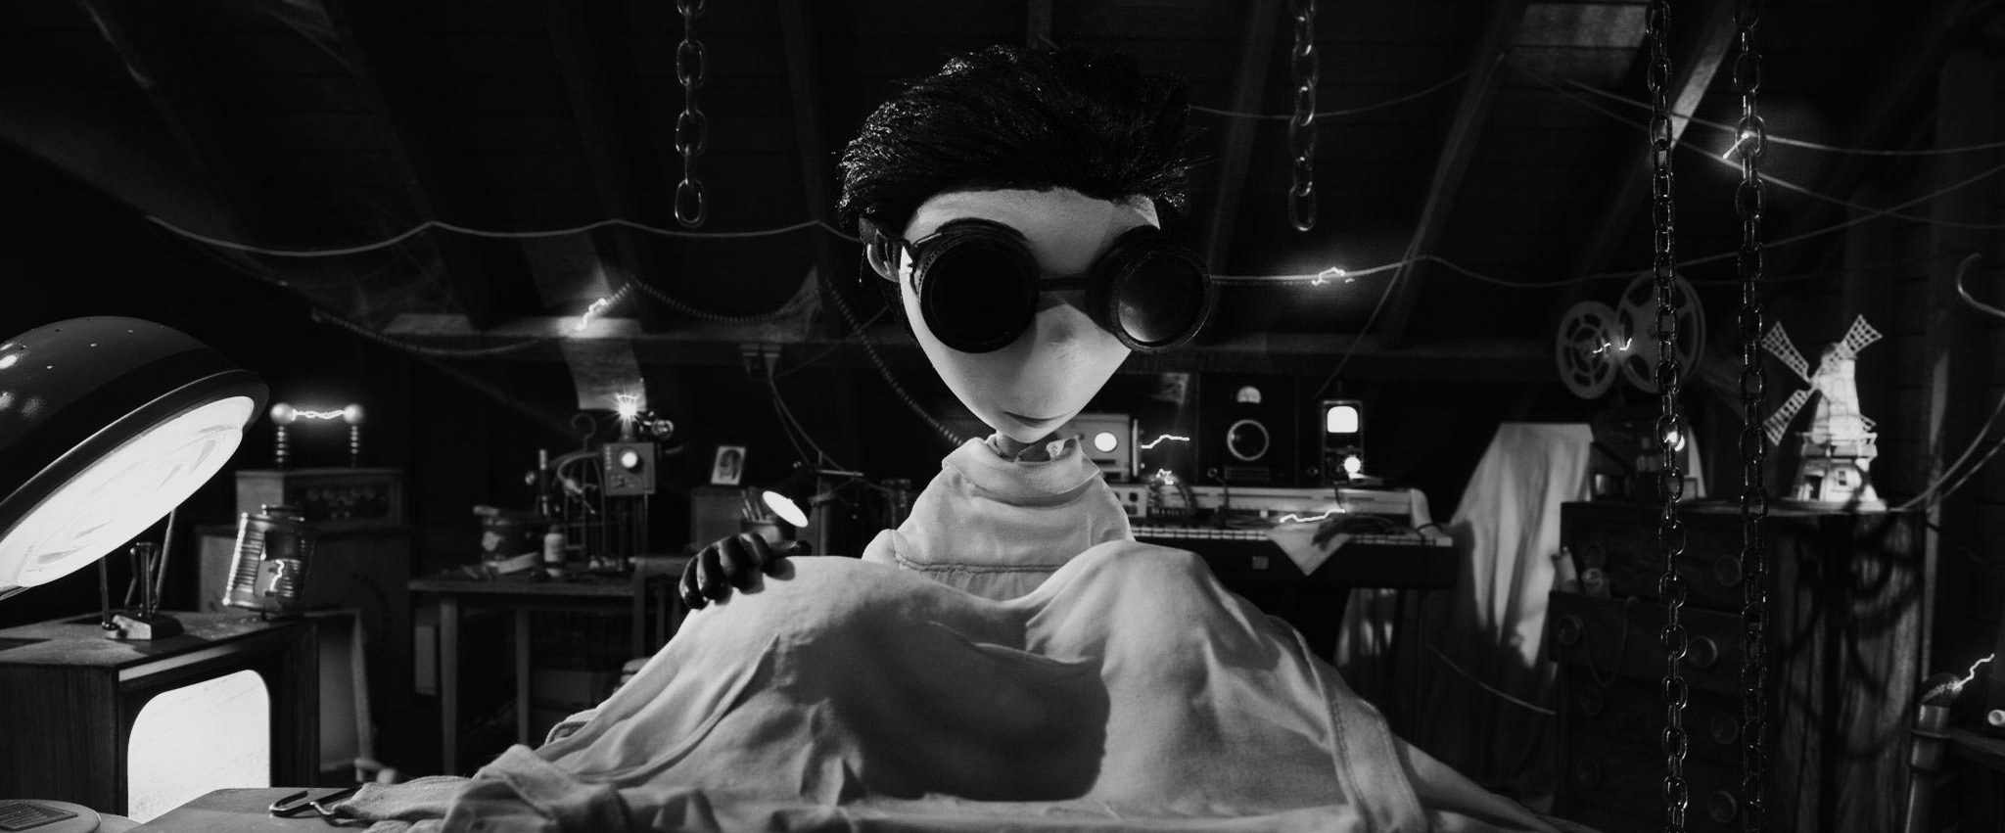
4.
4.
In a 2012 Tim Burton/Disney movie, a young boy is devastated when his dog is hit by a car. For his science project, he attempts to bring the dog back to life. What literary device is at work?
allusion
B. Flashback
Symbol
irony

Slide 6
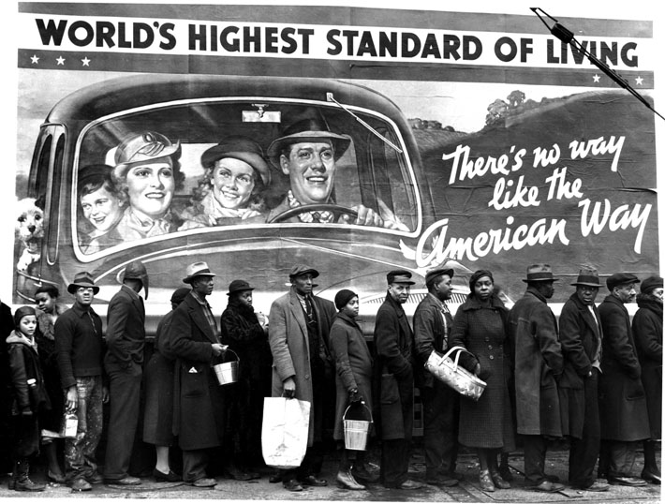
5.
This picture was taken after a Louisiana flood in 1937. What device is most evident?
Symbol B. Metaphor
C. Hyperbole D. Juxtaposition
Jeopardy
Level!

Slide 7
3. From an MC Lars song:
I miss Lenore, my Annabel Lee, taken by angels from me.Alone with books (hey that's me!), harbinger of death visiting me. I said, "Can I help you, evil prophet? If you got a problem, look, I'll solve it.“ He checked my hook, DJ revolved it, perched on Pallas, chalice dropped it. "Tell me sir, please, if you can. Am I good or evil man? What can I say, what can I do, when will I be rid of you?" "Nevermore," quothe he at me, hating on this fresh MC, Satanic raven, Niche glee, killing me softly like the Fugees.
The blue sections exhibit which literary device?
Metaphor
Allusion
Foreshadow
Alliteration
6.

Slide 8
7.
Note the lyrics from the Jay-Z song “Most Kings” and identify the literary device:
“Everybody want to be the king till shots ring…” A. Simile
Assonance
Personification
Metaphor

